Slide 1
DATA VISUALIZATION
18.04.2022

Slide 2
Key steps toward useful data dashboards.
Simple refers to the ease with which the visual reports can be interpreted. In other words, the key metrics should be on the top, and chart and graph headers should be simple and to the point.
All detailed information should be at the end with appropriate colours picked, the labels visible and ordered in a consistent manner.

Slide 3
CONTD.
Standard: Good visualization needs standardized data structure and elements. The complexities and disparities in presented data should be handled flawlessly and the redundancy eliminated.
Using common abbreviation, proper formatting, and identical scaling for charts, along with consistent layouts across your data visualizations will help convey clear and concise insight.

Slide 4
CONTD.
Scalable: Scalable refers to a visualization project’s ability to accommodate growing volumes of data and data sources without a hitch.
The increase should not impact the speed and performance of the reporting platform.

Slide 5
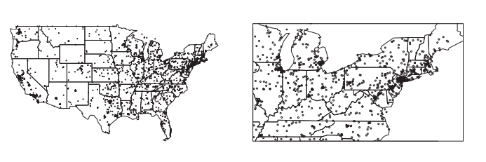
DOT MAPS
Point phenomena can be visualized by placing a symbol or pixel at the location where that phenomenon occurs. This simple visualization is called a dot map.
A quantitative parameter may be mapped to the size or the colour of the symbol or pixel. Circles are the most widely used symbol in dot maps, but squares, bars, or any other symbol can be used as well.
USA dot map: every circle represents the spatial location of an event. Even in the zoomed-in version there is a large degree of overlap.

Slide 6
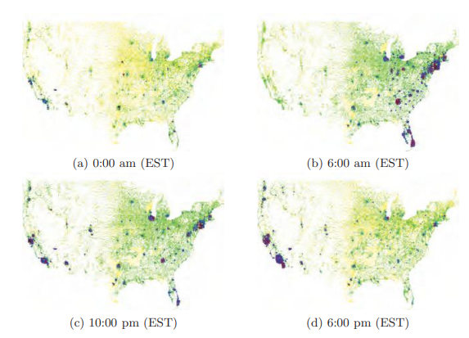
PixelMaps
One approach that does not aggregate the data, but avoids overlap in the two-dimensional display, is the PixelMap approach. The idea is to reposition pixels that would otherwise overlap.
Since the data points may not fit into the four sub regions, we must determine new extents of the sub regions (without changing the four subsets of data points), such that the data points in each subset can be visualized in their corresponding sub region.
The figures display U.S. Telephone Call Volume at four different times during one day. The idea is to place the first data items at their correct position and position overlapping data points at nearby unoccupied positions

Slide 7
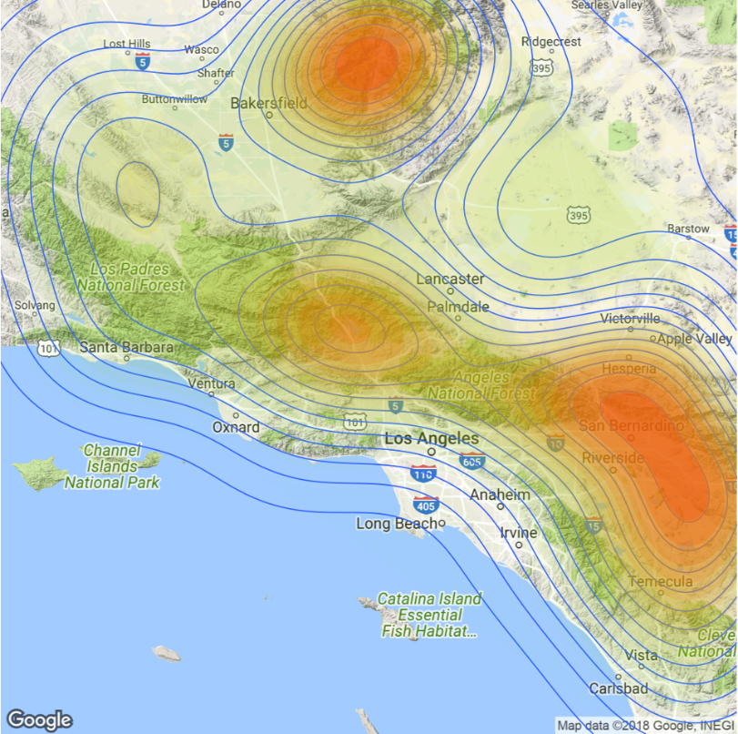
Line Data
The basic idea for visualizing spatial data describing linear phenomena is to represent them as line segments between pairs of endpoints specified by longitude and latitude.
A standard mapping of line data allows data parameters to be mapped to line width, line pattern, line colour, and line labelling.
In addition, data properties of the starting and ending points, as well as intersection points, may also be mapped to the visual parameters of the nodes, such as size, shape, colour, and labelling.
The lines do not need to be straight, but may be polylines or splines, in order to avoid clutter in the display.

Slide 8
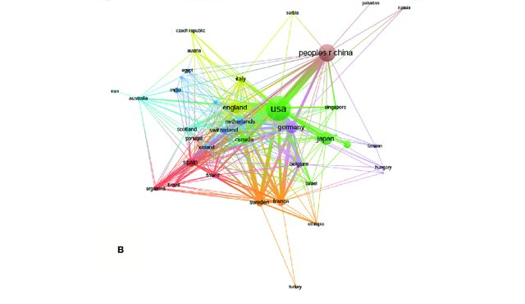
NETWORK MAPS
Network maps are widely used in a variety of applications. Some approaches only display the connectivity of networks for understanding their general behaviour and structure.

Slide 9
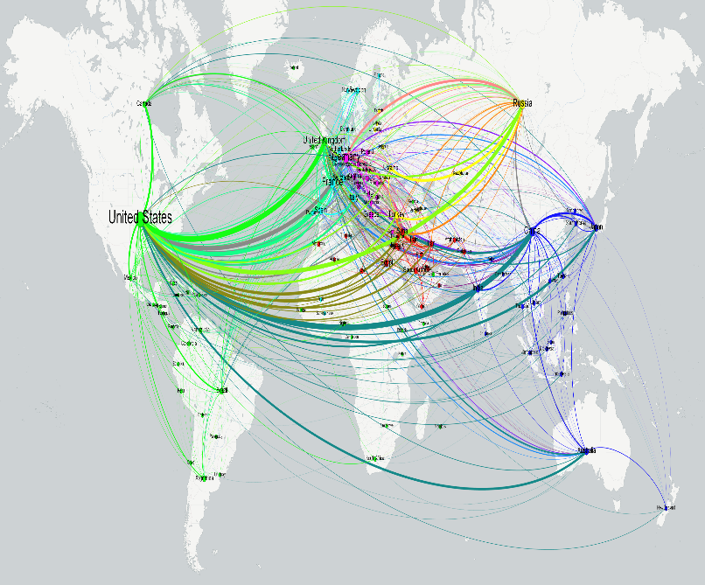
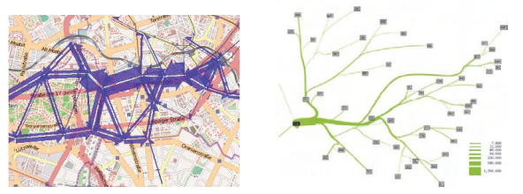
Flow Maps and Edge Bundling
The flow map technique is inspired by graph layout algorithms that minimize edge crossings and node position distortions, while retaining their relative positions.
Algorithmically, a hierarchical clustering based on node positions and flows between the nodes is performed to compute a useful merging and rerouting of flows
There are a number of approaches that try to avoid the overlap problem of traditional network maps by using curved lines instead of straight lines

Slide 10
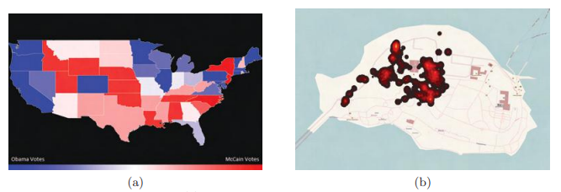
Visualization of Area Data
Thematic maps are the main approach to visualizing area phenomena. There are different variants of thematic maps.
The most popular type of thematic maps are choropleth maps (Greek: choro = area, pleth = value), in which the values of an attribute or statistical variable are encoded as coloured or shaded regions on the map
Thematic maps:
A choropleth map showing U.S. election results of the 2008 Obama versus McCain presidential election.
(b) An isarithmic map showing the number of pictures taken on Mainau Island, using a heat map, where the colors range from black to red to yellow, with yellow representing the most photographs.

Slide 11
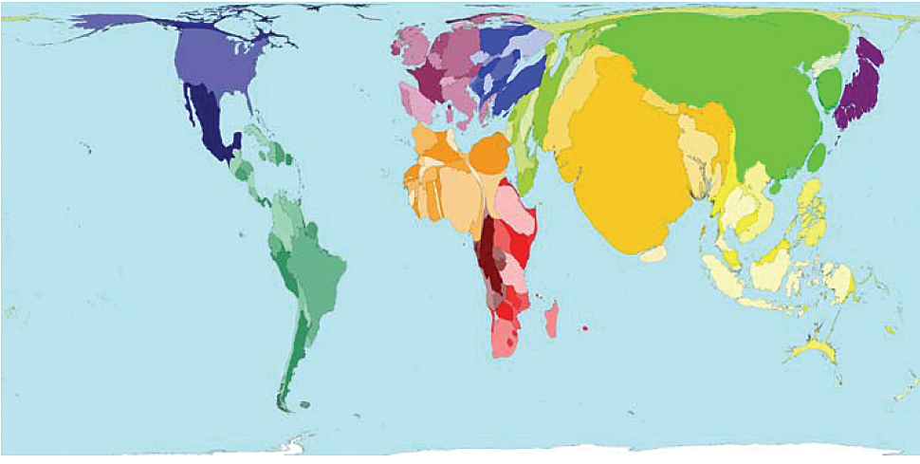
Cartogram
Cartograms are generalizations of ordinary thematic maps that avoid the problems of choropleth maps by distorting the geography according to the displayed statistical value.
Cartograms are a specific type of map transformation, where the regions are resized according to a geographically related input variable.
A cartogram is a thematic map of a set of features, in which their geographic size is altered to be directly proportional to a selected ratio-level variable

Slide 12
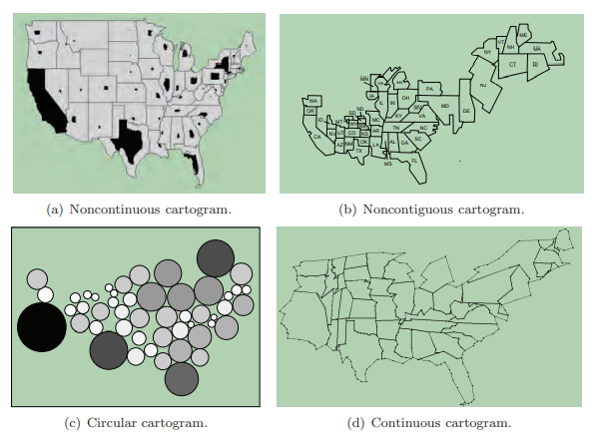
Contd.

